Slide 1

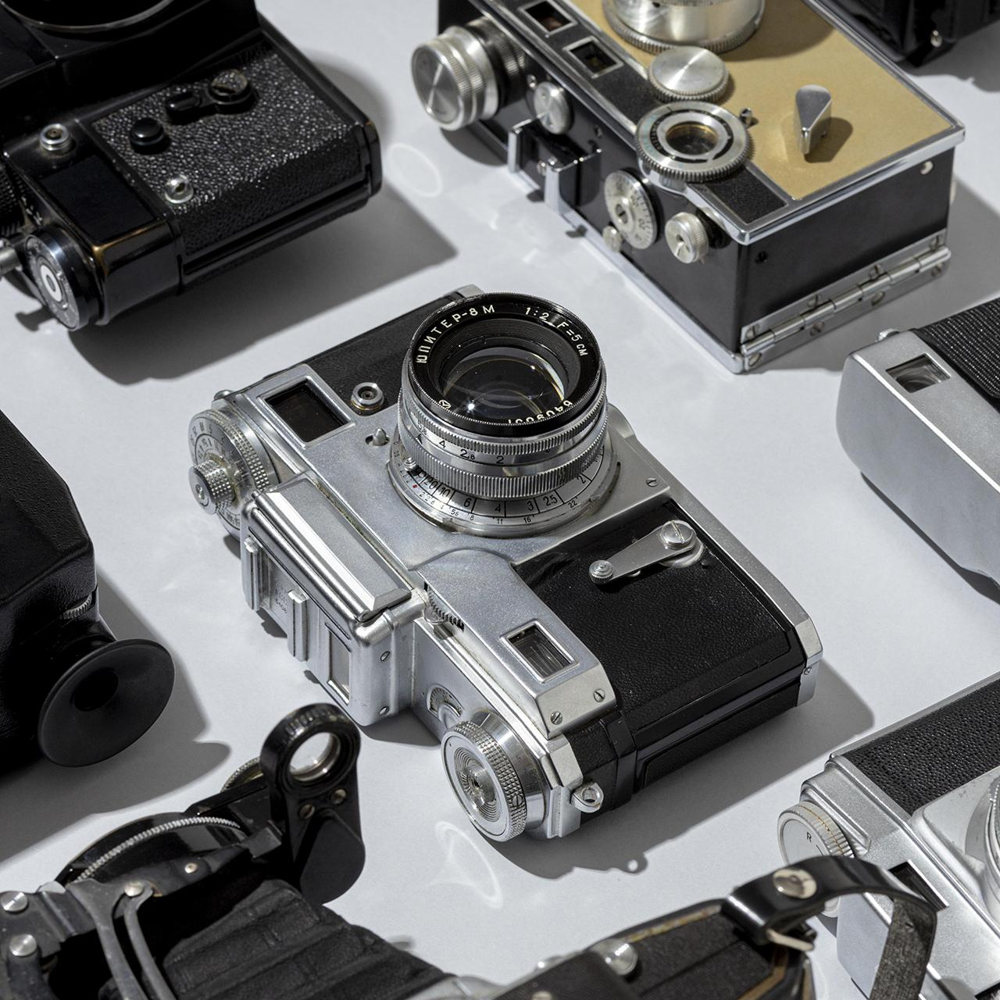
CAMERA Preferences
Choice Based Conjoint Analysis
Laboratory of Customer and Business Analytics
Shaker Mahmud Khandaker
Matricola 229221
Choice Based Conjoint Analysis

Slide 2
Overview
01
02
03
04
Exploratory
Data Analysis
MNL
Mixed MNL
Conclusions
Laboratory of Customer and Business Analytics
With Intercepts
Without Intercepts
With Uncorrelated Random Effects
With Fully correlated Random Effects
With partially correlated Random Effects
Choice Based Conjoint Analysis

Slide 3

01
Exploratory
Data Analysis
Laboratory of Customer and Business Analytics
Choice Based Conjoint Analysis

Slide 4
DATASET
Laboratory of Customer and Business Analytics
1
2
3
4
5
6
megapixels
max_resolution
shutter_speed
weight
screensize
Price
12
26
33
60
4240 x 2832
6240 x 4160
7008 x 4672
9504 x 6336
30 - 1/8000 sec
60 - 1/12000 sec
90 - 1/8000 sec
900 - 1/4000 sec
699g
755g
904g
1227g
2.4inch
2.6inch
3inch
3.2inch
999
1499
1799
2099
300 participants
4 product profiles each
25 questions each
Choice Based Conjoint Analysis

Slide 5

02
Multinomial Logit Model
Laboratory of Customer and Business Analytics
Choice Based Conjoint Analysis

Slide 6
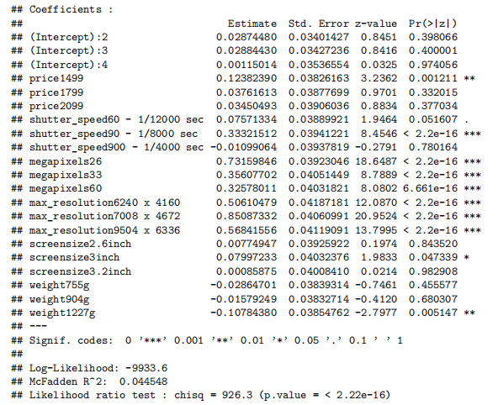
Laboratory of Customer and Business Analytics
For our first model, we will consider the intercept parameters.
We can see that, compared to other megapixels and weight levels, users are more likely to choose a camera with megapixels60 and weight1227g.
Choice Based Conjoint Analysis

Slide 7
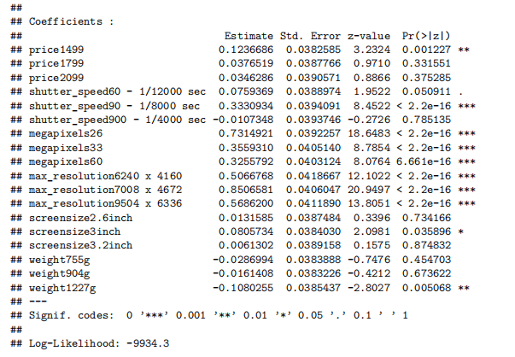
Laboratory of Customer and Business Analytics
For our second model, we will consider without the intercept parameters
Choice Based Conjoint Analysis

Slide 8
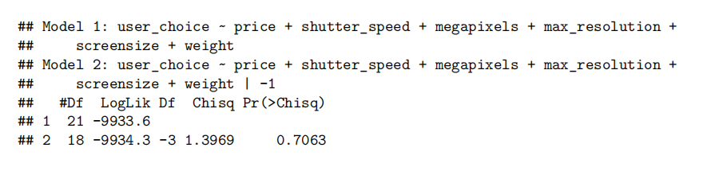
Choosing models
Laboratory of Customer and Business Analytics
Model 1: Fixed effect, with intercepts
Model 2: Fixed effects, no intercepts
No significant differences between the two models. This indicates that the intercept is not necessary to explain the variability in the response variable.
Choice Based Conjoint Analysis

Slide 9
Creating Profiles predicting Preference Share
Laboratory of Customer and Business Analytics
Let's create profiles based on 3 market levels: entry, midrange and flagship
 | megapixels | weight | screensize | max_resolution | shutter_speed | price | Preference share
Entry Level | 12 | 699g | 2.4inch | 4240 x 2832 | 900 - 1/4000 sec | 999 | 3.44%
 | 12 | 755g | 2.4inch | 6240 x 4160 | 900 - 1/4000 sec | 999 | 5.55%
 | 12 | 904g | 2.6inch | 4240 x 2832 | 90 - 1/8000 sec | 999 | 4.84%
 | 26 | 755g | 2.4inch | 6240 x 4160 | 30 - 1/8000 sec | 1499 | 13.20%
Mid range | 26 | 699g | 2.4inch | 6240 x 4160 | 90 - 1/8000 sec | 1499 | 18.95%
 | 33 | 755g | 2.6inch | 9504 x 6336 | 60 - 1/12000 sec | 1799 | 9.67%
 | 12 | 904g | 3inch | 7008 x 4672 | 90 - 1/8000 sec | 1499 | 13.71%
Flagship | 33 | 755g | 3inch | 7008 x 4672 | 60 - 1/12000 sec | 2099 | 13.68%
 | 33 | 1227g | 3.2inch | 9504 x 6336 | 30 - 1/8000 sec | 1799 | 8.23%
 | 60 | 904g | 3.2inch | 9504 x 6336 | 30 - 1/8000 sec | 2099 | 8.72%
Choice Based Conjoint Analysis

Slide 10
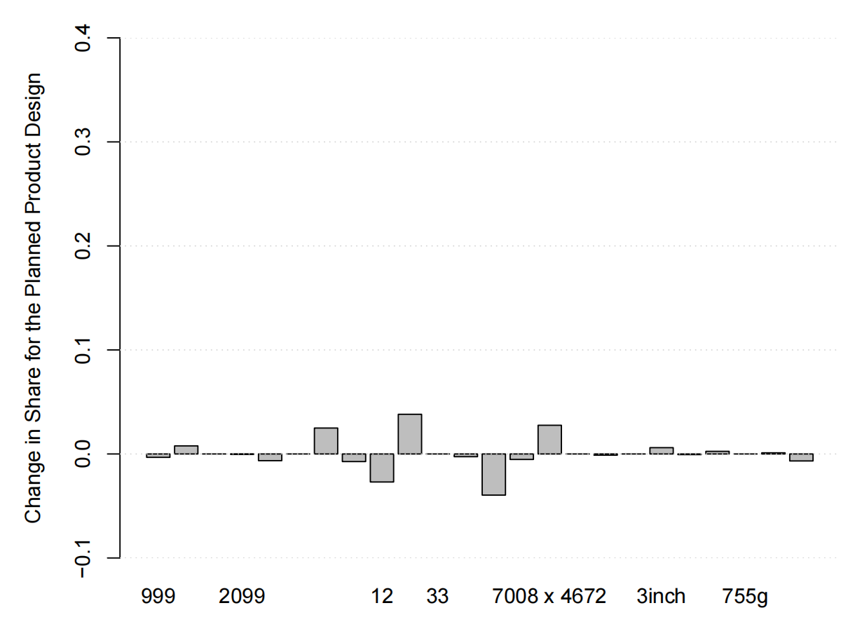
Trade-off attributes graph
Laboratory of Customer and Business Analytics
We can see that, decreasing the maximum resolution from 9504 x 6336 to 7008 x 4672 increases profile share by 2.76%.
Also, decreasing the megapixels from 33 to 26 increases by 3.8%.
Finally, changing the shutter speed to 90 - 1/8000 sec increases the profile share by 2.49%.
Any other changes decreases the percentage.
Choice Based Conjoint Analysis

Slide 11
03
Mixed Multinomial Logit Model
Laboratory of Customer and Business Analytics
Choice Based Conjoint Analysis

Slide 12
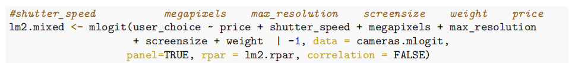
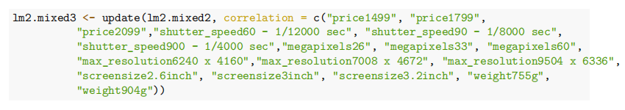
Laboratory of Customer and Business Analytics
We are going to create a model that takes in consideration random effects.
By analyzing the signs from random effect coefficients, we can update the model to contain just the variables that are correlated.
Choice Based Conjoint Analysis

Slide 13
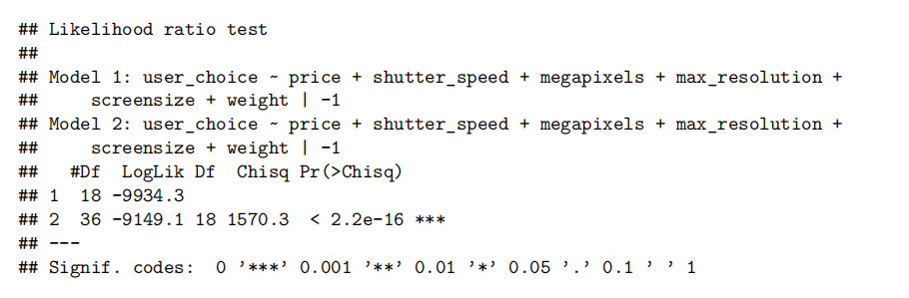
Choosing models - 01
Laboratory of Customer and Business Analytics
Model 1: Fixed effect, no intercepts
Model 2: Fixed effects vs. uncorrelated random effects
Model that consider heterogeneity is found to be a better fit than the model that assume the homogeneity.
Choice Based Conjoint Analysis

Slide 14
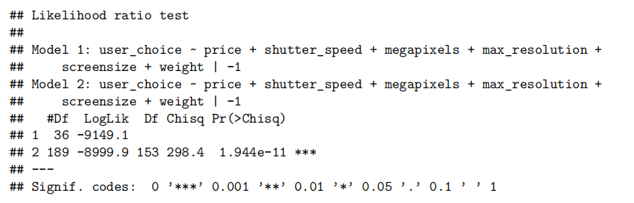
Choosing models - 02
Laboratory of Customer and Business Analytics
Model 1: Random effects, Uncorrelated
Model 2: Random effects, all correlated
Model with correlated random effects is a better fit than uncorrelated one.
Choice Based Conjoint Analysis

Slide 15
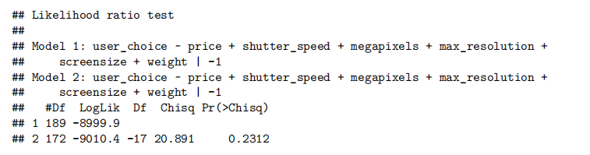
Choosing models - 03
Laboratory of Customer and Business Analytics
Model 1: Random effects, all correlated
Model 2: Random effects, partially correlated
Model with all correlated random effects is a better fit than partially correlated one.
Choice Based Conjoint Analysis

Slide 16
Updated Preference Share prediction
Laboratory of Customer and Business Analytics
 | megapixels | weight | screensize | max_resolution | shutter_speed | price | Preference share - fixed | Preference share - mixed
Entry Level | 12 | 699g | 2.4inch | 4240 x 2832 | 900 - 1/4000 sec | 999 | 3.44% | 2.64%
 | 12 | 755g | 2.4inch | 6240 x 4160 | 900 - 1/4000 sec | 999 | 5.55% | 4.16%
 | 12 | 904g | 2.6inch | 4240 x 2832 | 90 - 1/8000 sec | 999 | 4.84% | 5.64%
 | 26 | 755g | 2.4inch | 6240 x 4160 | 30 - 1/8000 sec | 1499 | 13.20% | 12.59%
Mid range | 26 | 699g | 2.4inch | 6240 x 4160 | 90 - 1/8000 sec | 1499 | 18.95% | 18.95%
 | 33 | 755g | 2.6inch | 9504 x 6336 | 60 - 1/12000 sec | 1799 | 9.67% | 9.04%
 | 12 | 904g | 3inch | 7008 x 4672 | 90 - 1/8000 sec | 1499 | 13.71% | 20.55%
Flagship | 33 | 755g | 3inch | 7008 x 4672 | 60 - 1/12000 sec | 2099 | 13.68% | 17.47%
 | 33 | 1227g | 3.2inch | 9504 x 6336 | 30 - 1/8000 sec | 1799 | 8.23% | 15.39%
 | 60 | 904g | 3.2inch | 9504 x 6336 | 30 - 1/8000 sec | 2099 | 8.72% | 6.15%
Choice Based Conjoint Analysis

Slide 17
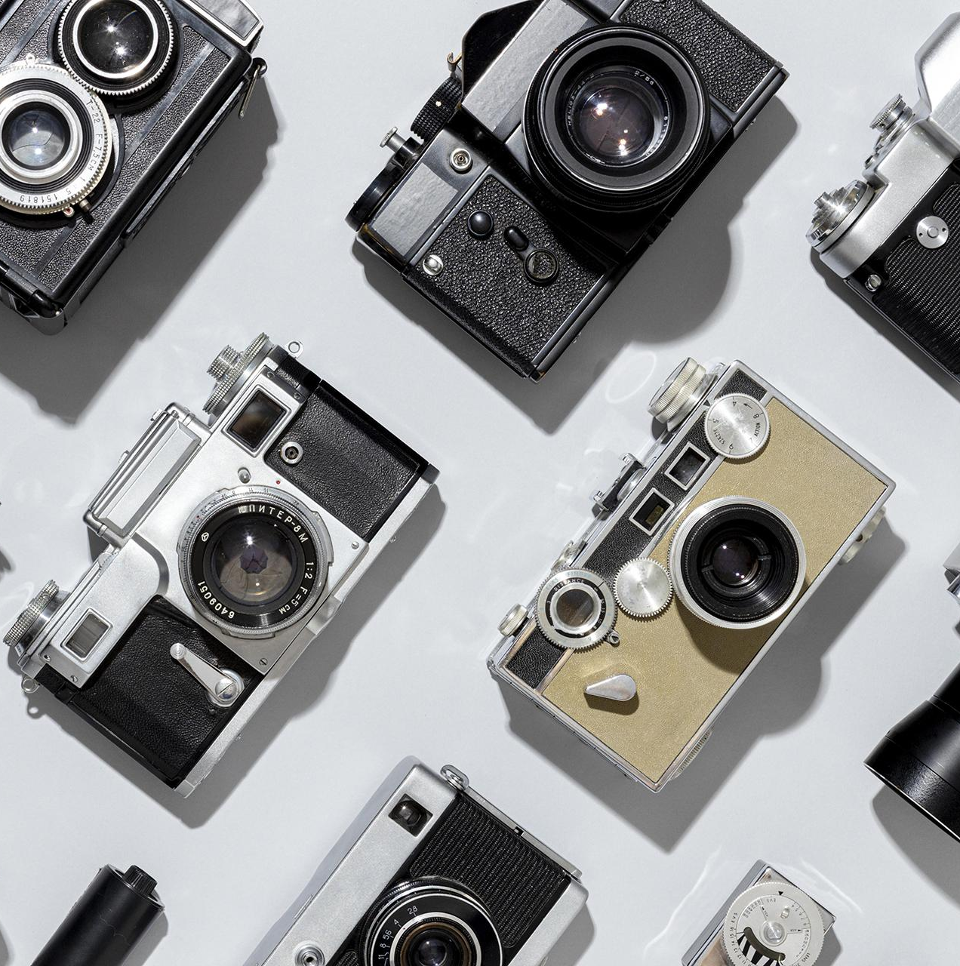
CONCLUSIONS
Laboratory of Customer and Business Analytics
Laboratory of Customer and Business Analytics
The attributes that represents the biggest change in preference in relation to our selected profile were shutter_speed, megapixels, max_resolution.
1
The insight that we get is user will prefer a lower price at a compromise on shutter_speed, megapixels and max_resolution. In this case, the preference share will change from ~9% to 21.49%.
2
Choice Based Conjoint Analysis
Choice Based Conjoint Analysis

Slide 18
Proposed Product profile
Laboratory of Customer and Business Analytics
 | megapixels | weight | screensize | max_resolution | shutter_speed | price | Preference share - mixed
Entry Level | 12 | 755g | 2.4inch | 4240 x 2832 | 900 - 1/4000 sec | 999 | 2.65%
 | 12 | 699g | 2.4inch | 6240 x 4160 | 900 - 1/4000 sec | 999 | 4.08%
 | 12 | 755g | 2.6inch | 4240 x 2832 | 90 - 1/8000 sec | 999 | 4.28%
 | 26 | 904g | 2.4inch | 6240 x 4160 | 30 - 1/8000 sec | 1499 | 12.31%
Mid range | 26 | 755g | 2.6inch | 7008 x 4672 | 90 - 1/8000 sec | 1499 | 21.49%
 | 26 | 699g | 2.4inch | 6240 x 4160 | 90 - 1/8000 sec | 1499 | 15.42%
 | 12 | 904g | 3inch | 7008 x 4672 | 90 - 1/8000 sec | 1499 | 12.28%
Flagship | 33 | 755g | 3inch | 7008 x 4672 | 60 - 1/12000 sec | 2099 | 14.94%
 | 33 | 1227g | 3.2inch | 9504 x 6336 | 30 - 1/8000 sec | 1799 | 6.19%
 | 60 | 904g | 3.2inch | 9504 x 6336 | 30 - 1/8000 sec | 2099 | 6.34%
Choice Based Conjoint Analysis

Slide 19
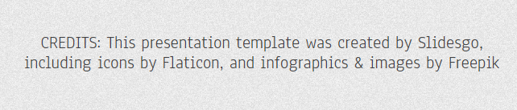
THANKS
Laboratory of Customer and Business Analytics
Laboratory of Customer and Business Analytics
SLIDESGOPHOTO.COM
Do you have any questions?
Choice Based Conjoint Analysis
Choice Based Conjoint Analysis

